Slide 1
PWM and Timer
by
CCEE_Wizards

Slide 2
TIMELINE
01
02
03
04
Project definition
Architecture
and Logic
Challenges
Solutions

Slide 3
01
Project definition

Slide 4
Project definition
What is a PWM? Timer?
Project goal: Design a configurable PWM generator using SystemVerilog

Slide 5
02
Architecture and Functionality

Slide 6
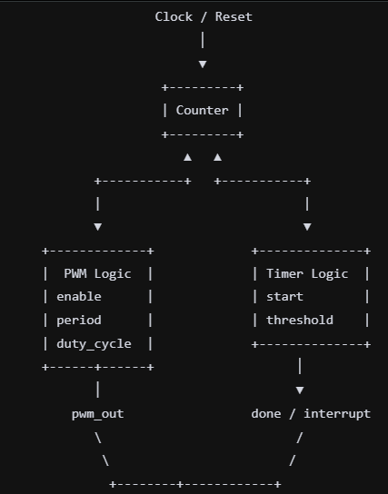
System Architecture
This is the architecture for ONE channel.
Purpose:
Combine PWM and Timer functionalities into a single module
Allow both to operate independently but concurrently using a shared counter to save resources.
Modular breakdown
Counter .
PWM Logic
Timer Logic

Slide 7
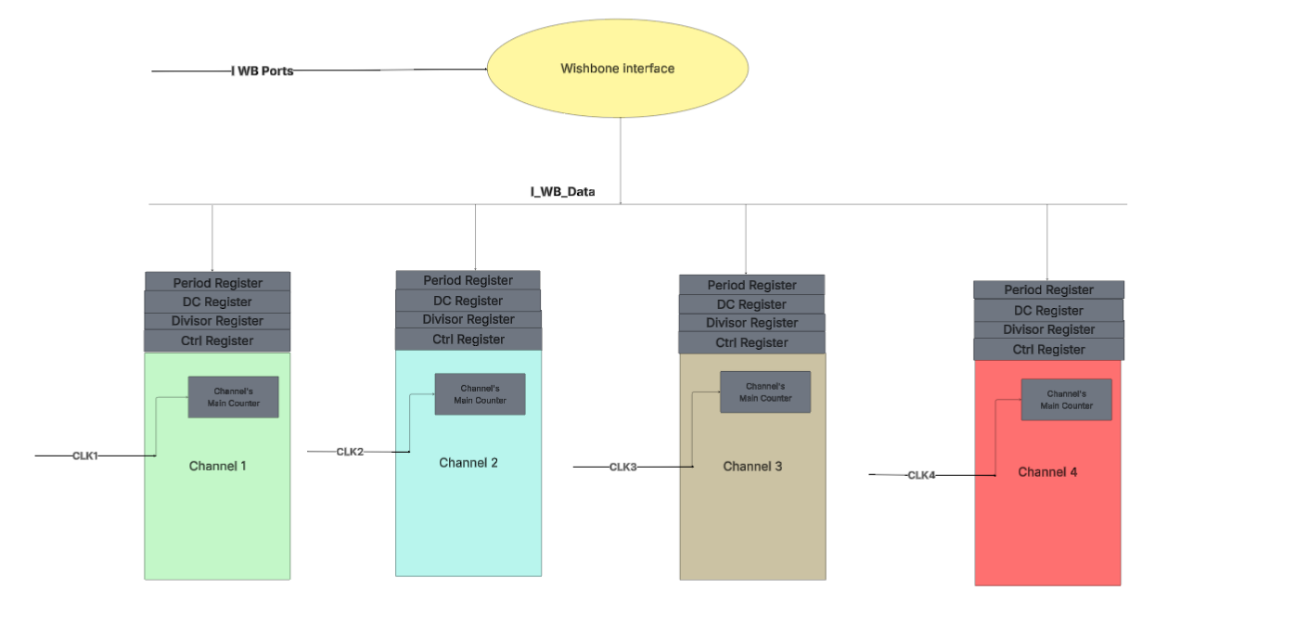
System Architecture

Slide 8
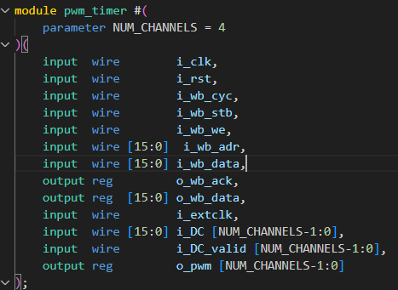
System Architecture
Inputs and Outputs for
Clk and rst
Wb interface
Clock selection
Duty cycle

Slide 9
FUNCTIONALITY
PWM
The pwm_out is generated on the main counter compared against the duty cycle , if mc<dc ? pwm_out=1 : =0. When counter ==period , counter resets to 0.
Timer
The counter increments until it’s >= the period
it raises the interrupt and o_pwm=interrupt
remain stuck until interrupt cleared or cont. bit=0
Counter
Feeds both timer and PWM and performs down clocking*

Slide 10
Error detection
Duty cycle > Period register is an error; we handle it by outputting high on o_pwm channel and raise an error signal.
Divisor register =0 is an error; we handle it by using divisor of 1 instead and raise an error signal.

Slide 11
03
Challenges Faced

Slide 12
Challenges
01
02
03
Down Clocking
Multi clock domain
Multi channel
To use it as a frequency divider
Each channel needs a clock, and system contains 2 clocks to pick from. Switching between clocks makes -Pulses- glitches.
Implementing 4 different channel with different DC/PERIODS

Slide 13
04
Solutions

Slide 14
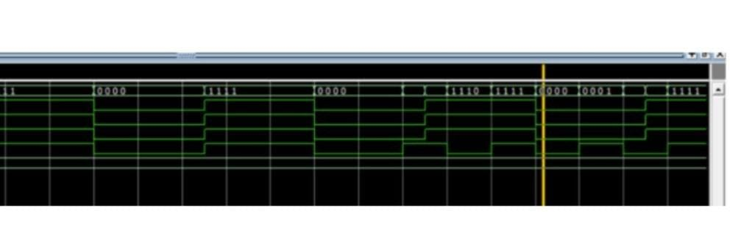
Multi clock Domain
Before
After
Solutions

Slide 15
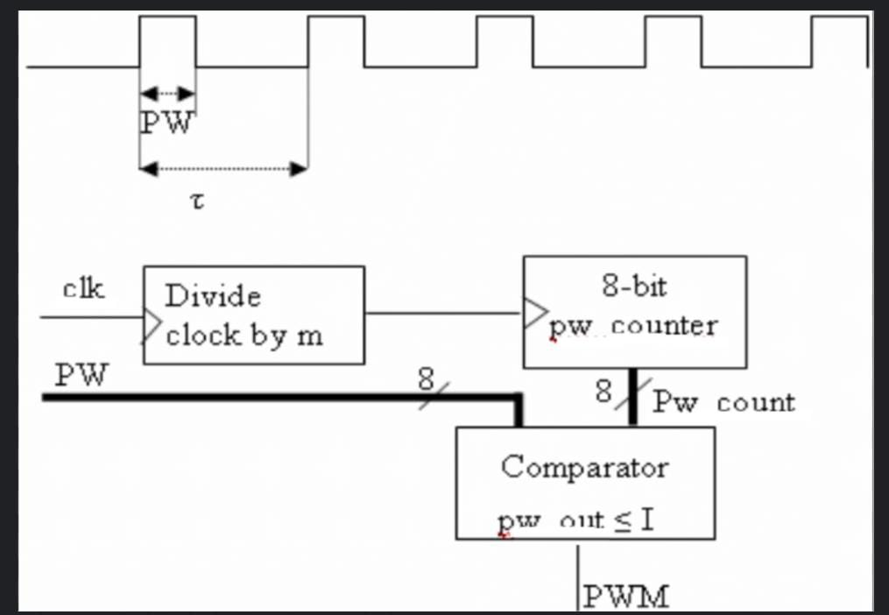
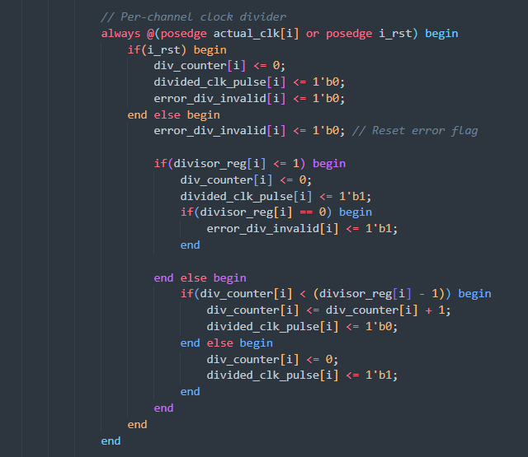
Down Clocking

Slide 16
Multi channel
Replicate resources for each channel

Slide 17
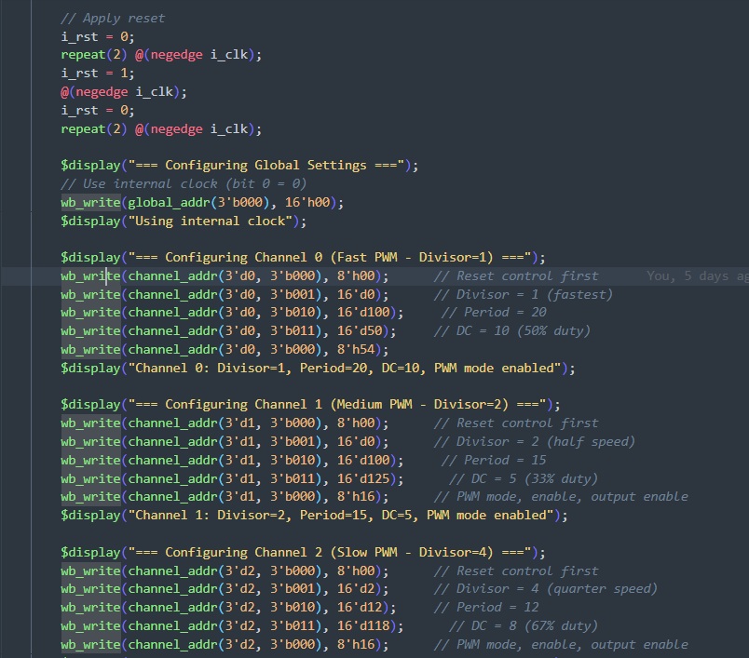
Testbench Flow

Slide 18
Results
Multi Channel
Divisor=2 && Divisor=10

Slide 19
Results
Wishbone
Read
Divisor=2 && Divisor=10
Write

Slide 20
Results
Timer Mode
Interrupt generation
Interrupt clearing

Slide 21
Synthesis

Slide 22
Thank you!

